Slide 1
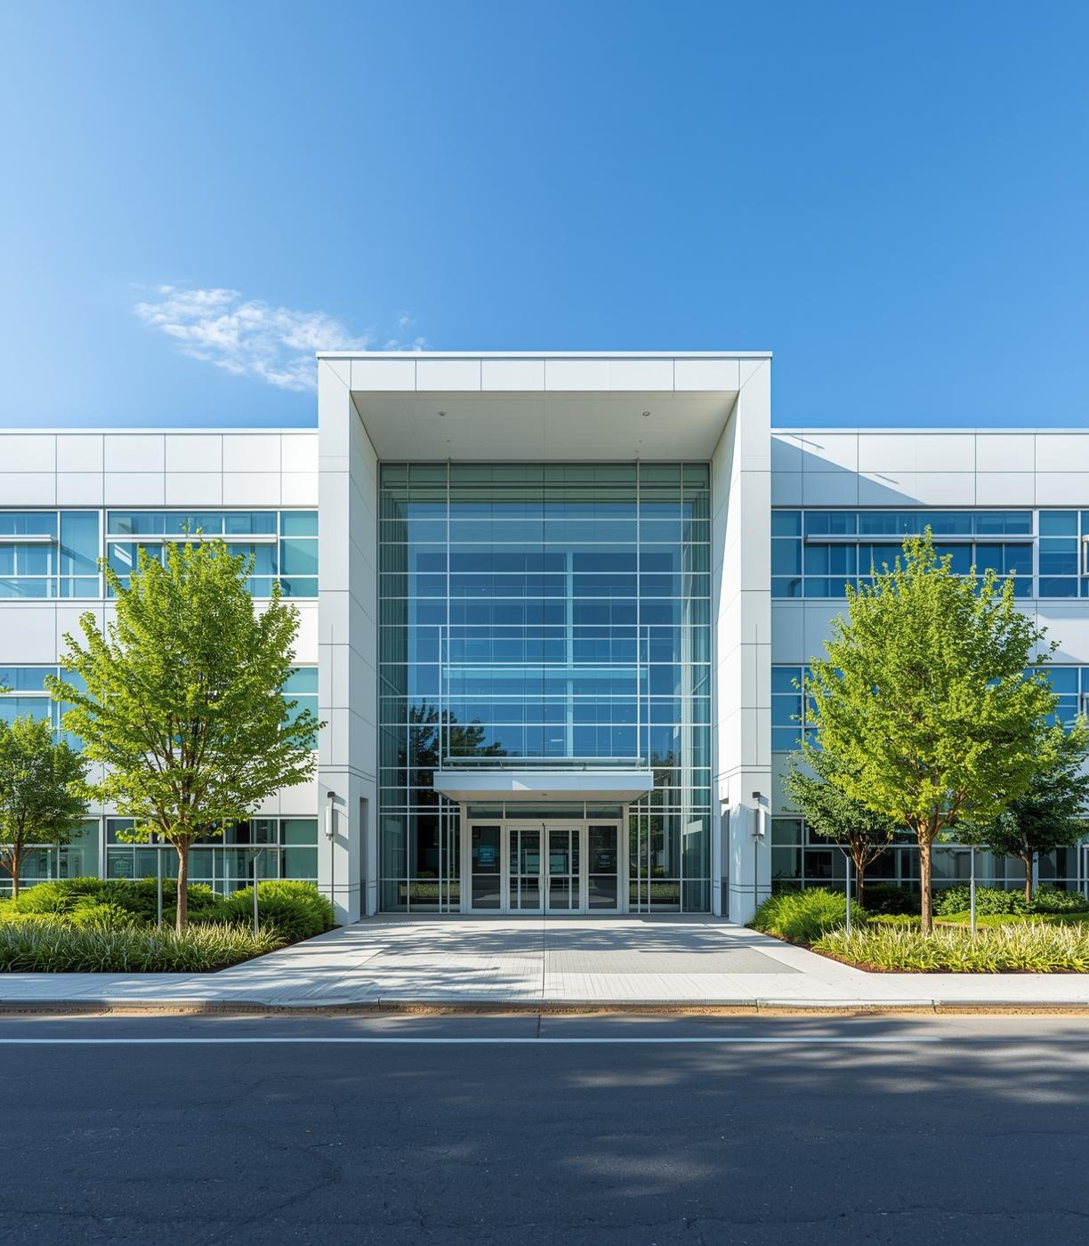
INTRODUCING AN INNOVATIVE SOLUTION
Hospital Patient Record System
Developed by Team Apex Coderz

Slide 2
The Hospital Patient Record System developed by Team Apex Coderz aims to revolutionize how hospitals manage patient information. By transitioning from manual record-keeping to a computerized solution, this system enhances efficiency, accuracy, and reliability. Utilizing the C programming language, the system allows for seamless storing, retrieving, updating, and deleting of patient records. This innovative approach not only simplifies record management but also paves the way for future scalability and advanced functionalities.
Introduction to System

Slide 3
The Hospital Patient Record System is designed to efficiently manage patient information within hospitals. It allows users to store, retrieve, update, and delete patient data, ensuring accuracy and quick access to vital health records in a streamlined manner, enhancing overall operational efficiency.
Project Overview
Driven by the need to replace outdated manual methods, this system is developed in C language, combining simplicity and functionality to address real-world healthcare challenges effectively.

Slide 4
The Hospital Patient Record System streamlines hospital record-keeping by managing patient information efficiently. Developed in C language, it allows users to store, retrieve, update, and delete patient data effortlessly. The system employs modular programming principles, utilizing arrays and functions to ensure organized data management. With a lightweight text-based interface, it is designed for ease of use and scalability, paving the way for future enhancements such as graphical user interfaces and integration with larger databases.
Project Abstract

Slide 5
The inefficiencies of manual record-keeping in hospitals often lead to significant errors, duplication of data, and slow access to vital information. This outdated system hinders the ability to provide timely and accurate patient care. By transitioning to a computerized system, we aim to eliminate these inefficiencies, ensuring improved accuracy and reliability in managing patient records. Our project seeks to establish a systematic approach to data management that is both scalable and efficient.
Problem Statement

Slide 6
Need for Automation
Accuracy in patient record-keeping is essential; a computerized system minimizes human errors, ensuring that medical information is precise and up-to-date for better patient care.
Reliability is greatly improved with automation; electronic systems provide consistent access to patient records, reducing the risk of lost or misplaced documentation, thus enhancing overall operational efficiency.
Scalability is crucial for growth; an automated system can easily adapt to increasing patient data as hospitals expand, ensuring that the management of records remains efficient and effective.

Slide 7
The primary goal of the Hospital Patient Record System is to develop an automated solution to enhance hospital record management. Key objectives include implementing modular programming in C, ensuring ease of maintenance through separate functions for adding, updating, deleting, and retrieving patient information. The project aims to utilize arrays and loops for structured data management, incorporate input validation, and provide a user-friendly command-line interface that facilitates efficient access to patient records and statistical insights.
Project Objectives

Slide 8
Program Design and Logic Overview
Modular Architecture
Data Structures
Main Modules
The system employs a modular architecture, allowing for separation of functionalities, enhancing maintainability, and enabling isolated testing of individual modules for better reliability.
Arrays are utilized for storing patient information, such as names, ages, and diseases, providing structured data management and facilitating efficient data retrieval and updates.
Key modules include input, display, search, deletion, and report functionalities, each encapsulated in specific functions to optimize performance and create a streamlined user experience.

Slide 9
In the Hospital Patient Record System, arrays play a crucial role in managing patient information efficiently. They are used to store data such as patient names, ages, and diseases in a structured manner. Each array allows for quick access and manipulation of patient records, enabling operations like searching, updating, and deleting information. This approach ensures that the system remains scalable, maintaining performance even as the number of records increases over time.
Data Structures

Slide 10
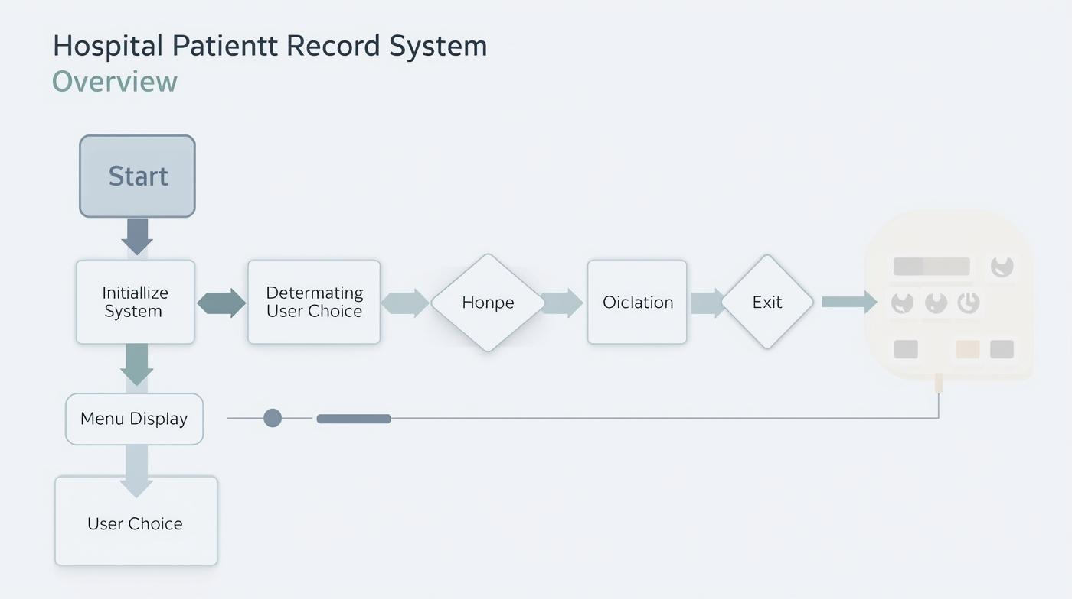
Program Flowchart
Process Overview
Flowchart illustrating program process steps.

Slide 11
Key Features of the Code Implementation
Standard Libraries
Constants
Programming Constructs
The program utilizes essential C standard libraries, including stdio.h for input/output operations and string.h for handling string manipulations effectively.
Constants define the maximum number of patients and name lengths, ensuring that memory usage is optimized and data integrity is maintained throughout program execution.
The code employs loops, conditionals, and array management, enabling efficient data handling, user input validation, and systematic processing of patient records for accurate results.

Slide 12
The addPatient() function is designed to streamline the process of adding new patient records to the database. It prompts the user for essential details such as the patient's name, age, and medical condition. Input validation ensures that the data entered is accurate and within acceptable ranges. By utilizing arrays, this function efficiently stores patient information, enhancing the overall usability of the Hospital Patient Record System and minimizing the risk of data entry errors.
addPatient() Function

Slide 13
The Hospital Patient Record System utilizes several crucial code features to ensure functionality and reliability. The menu loop keeps the program running, allowing users to make multiple entries without restarting. Input validation guarantees correct data entry, enhancing overall accuracy. Array management is essential for maintaining data integrity, while statistical computations facilitate insightful reports on patient demographics, ensuring the system is both user-friendly and efficient in handling hospital data management needs.
Key Code Features

Slide 14
Throughout the development of the Hospital Patient Record System, we encountered several challenges that tested our programming skills. One significant difficulty was managing array element shifting during patient record deletion, which required careful indexing. Additionally, we faced various syntax and logic errors that surfaced during debugging, demanding thorough checks. Overcoming these obstacles not only improved our technical abilities but also enhanced our teamwork and problem-solving approaches in real-world scenarios.
Challenges Faced

Slide 15
Throughout the development of the Hospital Patient Record System, we gained significant insights into structured programming. Our enhanced understanding of modular design allowed us to break down complex problems into manageable components. This approach not only improved code readability but also facilitated easier debugging and maintenance. Additionally, we learned the importance of input validation and error handling, ensuring that our program would efficiently manage user data while minimizing the risk of errors and crashes.
Lessons Learned

Slide 16
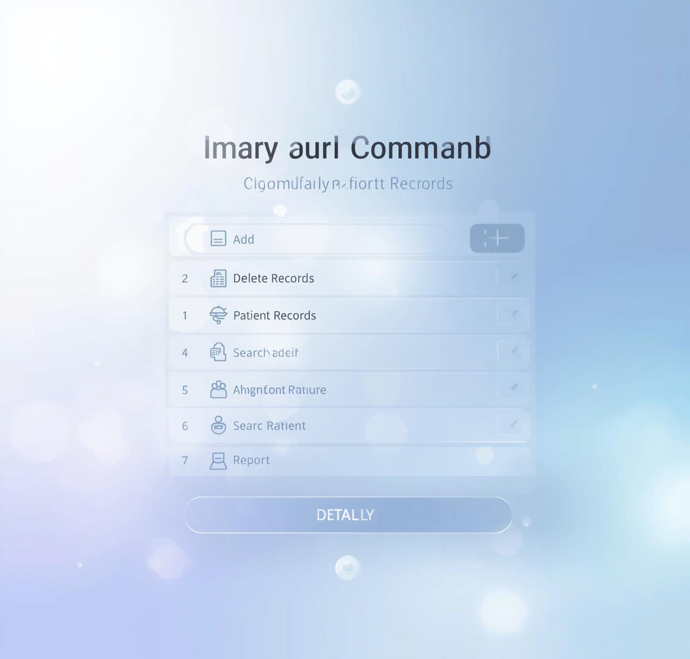
User Interface

Slide 17

Conclusion
Thank you for your attention and questions
EMAIL
hello@reallygreatsite.com
PHONE
123-456-7890
SOCIAL MEDIA
@reallygreatsite

